Slide 1
Unit 2
Abstraction Mechanism: Encapsulation, Constructors, Destructors, Polymorphism, Access Specification: Private, Public and Protected member

Slide 2
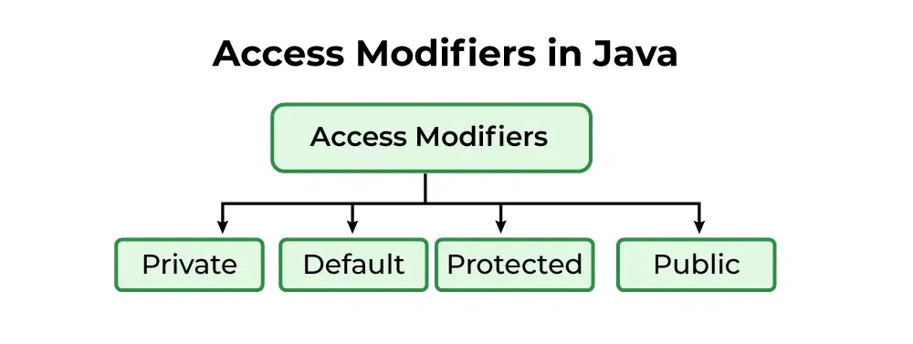
Access Modifiers
In Java, Access modifiers helps to restrict the scope of a class, constructor, variable, method, or data member. It provides security, accessibility, etc. to the user depending upon the access modifier used with the element. In this article, let us learn about Java Access Modifiers, their types, and the uses of access modifiers.
Types of Access Modifiers
There are 4 types of access modifiers available in Java:
Default – No keyword required
Private
Protected
Public

Slide 3
1. Default Access Modifier
When no access modifier is specified for a class, method, or data member, it is said to be having the default access modifier by default. The default access modifiers are accessible only within the same package.
Example 1: Demonstrating Default Access Modifier Within the Same Package. In this example, we will create two packages and the classes in the packages will be having the default access modifiers and we will try to access a class from one package from a class of the second package.
// default access modifier
package p1;
// Class Access is having Default access modifier
class Access
{
void display()
{
System.out.println("Hello World!");
}
}

Slide 4
Example 2: Error when Accessing Default Modifier Class across Packages. In this example, the program will show the compile-time error when we try to access a default modifier class from a different package.
// error while using class from different package with default modifier
package p2;
import p1.*; // importing package p1
// This class is having default access modifier
class AccessNew {
public static void main(String args[]) {
// Accessing class Access from package p1
Access o = new Access();
o.display();
}
}

Slide 5
2. Private Access Modifier
The private access modifier is specified using the keyword private. The methods or data members declared as private are accessible only within the class in which they are declared.
Any other class of the same package will not be able to access these members.
Top-level classes or interfaces can not be declared as private because,
private means “only visible within the enclosing class“.
protected means “only visible within the enclosing class and any subclasses“.
Hence these modifiers in terms of application to classes, apply only to nested classes and not on top-level classes.
Example: In this example, we will create two classes A and B within the same package p1. We will declare a method in class A as private and try to access this method from class B and see the result.
The above code will show a compile-time error when trying to access a private method from class B, even within the same package.
// error while using class from different package with
// private access modifier
package p1;
// Class A
class A {
private void display() {
System.out.println(“Hello");
}
}
// Class B
class B {
public static void main(String args[]) {
A obj = new A();
// Trying to access private method
// of another class
obj.display();
}
}

Slide 6
3. Protected Access Modifier
The protected access modifier is specified using the keyword protected. The methods or data members declared as protected are accessible within the same package or subclasses in different packages.
Example 1: In this example, we will create two packages p1 and p2. Class A in p1 is made public, to access it in p2. The method display in class A is protected and class B is inherited from class A and this protected method is then accessed by creating an object of class B.
// protected access modifier
package p1;
// Class A
public class A {
protected void display() {
System.out.println(“Hello");
}
}
So, it demonstrates that a protected method is accessible within the same package.

Slide 7
Example 2: In this example, we will create two packages, p1 and p2. Class A in p1 has a protected method display. Class B in p2 extends A and accesses the protected method through inheritance by creating an object of class B.
// protected modifier
package p2;
// importing all classes
// in package p1
import p1.*;
// Class B is subclass of A
class B extends A {
public static void main(String args[]) {
B obj = new B();
obj.display();
}
}
Explanation: The above example demonstrates that a protected method is accessible in a subclass from a different package using inheritance.

Slide 8
4. Public Access Modifier
The public access modifier is specified using the keyword public.
The public access modifier has the widest scope among all other access modifiers.
Classes, methods, or data members that are declared as public are accessible from everywhere in the program. There is no restriction on the scope of public data members.
Example 1: Here, the code shows that a public method is accessible within the same package.
// public modifier
package p1;
public class A {
public void display() {
System.out.println(“Hello");
}
}
Example 2: Here, the example shows that a public method is accessible across packages.
// public access modifier
package p2;
import p1.*;
class B {
public static void main(String args[]) {
A obj = new A();
obj.display();
}}
If other programmers use your class, try to use the most restrictive access level that makes sense for a particular member. Use private unless you have a good reason not to.
Avoid public fields except for constants.

Slide 9
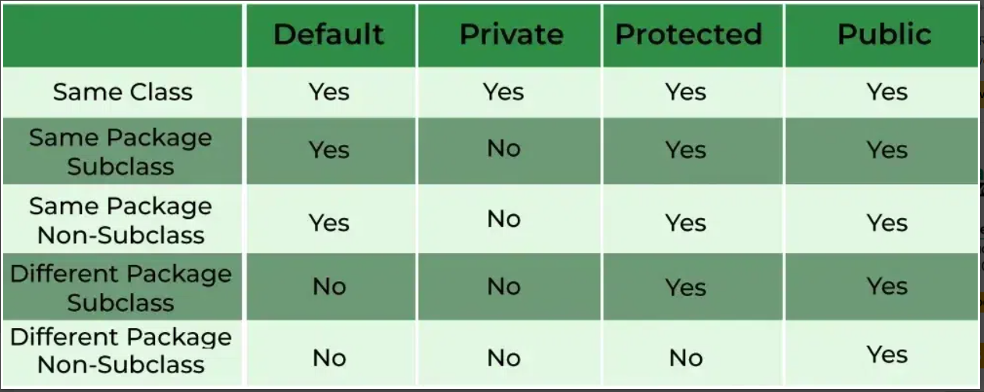
Comparison Table of Access Modifiers in Java

Slide 10
Algorithm to Use Access Modifier in Java
Here’s a basic algorithm for using access modifiers in Java:
Define a class: Create a class to represent the object you want to manage.
Define instance variables: Inside the class, define variables for the data you want to manage.
Set an access modifier:
Use private for variables only accessible within the class.
Use protected for variables accessible within the class and its subclasses.
Use public for variables accessible from anywhere.
Use getter and setter methods: To access or modify variables, use getter (accessor) and setter (mutator) methods, even for public variables, to maintain encapsulation.

Slide 11
Constructors
// Java Program to demonstrate Constructor
import java.io.*;
// Driver Class
class Driver {
// Constructor
Driver()
{
super();
System.out.println("Constructor Called");
}
// main function
public static void main(String[] args)
{
Driver drive = new Driver();
}
}
Java constructors or constructors in Java is a terminology used to construct something in our programs. A constructor in Java is a special method that is used to initialize objects. The constructor is called when an object of a class is created. It can be used to set initial values for object attributes.
What are Constructors in Java?
In Java, a Constructor is a block of codes similar to the method. It is called when an instance of the class is created. At the time of calling the constructor, memory for the object is allocated in the memory. It is a special type of method that is used to initialize the object. Every time an object is created using the new() keyword, at least one constructor is called.
Note: It is not necessary to write a constructor for a class. It is because the java compiler creates a default constructor (constructor with no arguments) if your class doesn’t have any.

Slide 12
How Java Constructors are Different From Java Methods?
Constructors must have the same name as the class within which it is defined it is not necessary for the method in Java.
Constructors do not return any type while method(s) have the return type or void if does not return any value.
Constructors are called only once at the time of Object creation while method(s) can be called any number of times.
Now let us come up with the syntax for the constructor being invoked at the time of object or instance creation.
The first line of a constructor is a call to super() or this(), (a call to a constructor of a super-class or an overloaded constructor), if you don’t type in the call to super in your constructor the compiler will provide you with a non-argument call to super at the first line of your code, the super constructor must be called to create an object:
If you think your class is not a subclass it actually is, every class in Java is the subclass of a class object even if you don’t say extends object in your class definition.
class Construct { ....... // A Constructor Construct() { } ....... } // We can create an object of the above class using the below
statement. This statement calls above constructor. Construct obj = new Construct();

Slide 13
Need of Constructors in Java
Think of a Box. If we talk about a box class then it will have some class variables (say length, breadth, and height). But when it comes to creating its object(i.e Box will now exist in the computer’s memory), then can a box be there with no value defined for its dimensions? The answer is No. So constructors are used to assign values to the class variables at the time of object creation, either explicitly done by the programmer or by Java itself (default constructor).
When Java Constructor is called?
Each time an object is created using a new() keyword, at least one constructor (it could be the default constructor) is invoked to assign initial values to the data members of the same class. Rules for writing constructors are as follows:
The constructor(s) of a class must have the same name as the class name in which it resides.
A constructor in Java can not be abstract, final, static, or Synchronized.
Access modifiers can be used in constructor declaration to control its access i.e which other class can call the constructor.
So by far, we have learned constructors are used to initialize the object’s state. Like methods , a constructor also contains a collection of statements(i.e. instructions) that are executed at the time of Object creation.

Slide 14
Types of Constructors in Java
Now is the correct time to discuss the types of the constructor, so primarily there are three types of constructors in Java are mentioned below:
Default Constructor
Parameterized Constructor
Copy Constructor
1. Default Constructor in Java
A constructor that has no parameters is known as default constructor. A default constructor is invisible. And if we write a constructor with no arguments, the compiler does not create a default constructor. It is taken out. It is being overloaded and called a parameterized constructor. The default constructor changed into the parameterized constructor. But Parameterized constructor can’t change the default constructor. The default constructor can be implicit or explicit.
Implicit Default Constructor: If no constructor is defined in a class, the Java compiler automatically provides a default constructor. This constructor doesn’t take any parameters and initializes the object with default values, such as 0 for numbers, null for objects.
Explicit Default Constructor: If we define a constructor that takes no parameters, it’s called an explicit default constructor. This constructor replaces the one the compiler would normally create automatically. Once you define any constructor (with or without parameters), the compiler no longer provides the default constructor for you.

Slide 15
// Java Program for Parameterized Constructor
import java.io.*;
class Test {
// data members of the class.
String name;
int id;
Test(String name, int id) {
this.name = name;
this.id = id;
}
}
class Test2
{
public static void main(String[] args)
{
// This would invoke the parameterized constructor.
Test Obj = new Test("Avinash", 68);
System.out.println(“TestName :" + test1.name
+ " and TestId :" + test1.id);
}
}
// Java Program to demonstrate Default Constructor
import java.io.*;
// Driver class
class Driver {
// Default Constructor
Driver() { System.out.println("Default constructor"); }
// Driver function
public static void main(String[] args)
{
Driver hello = new Driver();
}
}

Slide 16
2. Parameterized Constructor in Java:
A constructor that has parameters is known as parameterized constructor. If we want to initialize fields of the class with our own values, then use a parameterized constructor.
3. Copy Constructor in Java
Unlike other constructors copy constructor is passed with another object which copies the data available from the passed object to the newly created object.
Note: In Java,there is no such inbuilt copy constructor available like in other programming languages such as C++, instead we can create our own copy constructor by passing the object of the same class to the other instance(object) of the class.

Slide 17
Destructor
In programming, a destructor is a method called when an object is destroyed, typically to release resources like memory, file handles, or network connections. In languages like C++, destructors are explicitly used to manage resource cleanup. However, Java takes a different approach due to its automatic memory management system powered by garbage collection.
Destructor in Java
Java does not have explicit destructors like C++ because the garbage collector automatically manages Java’s memory. Garbage collection tracks objects in memory, and when they are no longer referenced, it automatically reclaims the memory.
Although Java does not provide destructors, it used to have a method called finalize() that could be overridden to define cleanup operations before an object is garbage collected. The finalize() method has been deprecated since Java 9 and removed in Java 18 due to its unpredictability and performance overhead. Instead, modern Java programs rely on other mechanisms for resource management, such as AutoCloseable and try-with-resources.

Slide 18
Advantages of Destructors
Automatic Resource Management: By automating the process of freeing up memory and other resources, Java's garbage collector lowers the possibility of memory leaks and improper resource management.
Simplifies Programming: By eliminating the need for developers to manually monitor and release memory, programming becomes simpler and less prone to error.
Enhances Performance: By effectively handling memory allocation and deallocation, automated memory management can aid in performance optimization.
Memory Management in Java
Java’s garbage collector automatically manages the lifecycle of objects.
When no references point to an object, it becomes eligible for garbage collection.
The garbage collector reclaims memory at its discretion, making memory management automated and simplifying development.

Slide 19
Why Java Doesn’t Need Destructors?
In languages like C++, destructors are essential because programmers manually manage memory allocation and deallocation. In contrast, Java developers don’t have to worry about this due to its automatic garbage collection system. Instead of destructors, developers in Java can handle resource management using the try-with-resources statement and AutoCloseable interface, ensuring resources like files, database connections, or sockets are properly closed.
Alternatives to Finalization in Java
AutoCloseable and try-with-resources:
This is the preferred method for managing resources that require cleanup, such as file streams, database connections, or network sockets.
The try-with-resources statement ensures that resources are automatically closed after usage, without relying on the garbage collector's unpredictable behavior.
java.lang.ref.Cleaner Class:
For advanced cleanup tasks where AutoCloseable is not sufficient, Java 9 introduced the Cleaner class as a replacement for finalize().
Cleaner allows you to register cleanup actions that are invoked once the object becomes unreachable, without the issues associated with finalize().

Slide 20
Abstraction
Abstraction in Java is the process of hiding the implementation details and only showing the essential functionality or features to the user. This helps simplify the system by focusing on what an object does rather than how it does it. The unnecessary details or complexities are not displayed to the user.
Television remote control is an excellent example of abstraction. It simplifies the interaction with a TV by hiding the complexity behind simple buttons and symbols, making it easy without needing to understand the technical details of how the TV functions.
Abstraction Real-Life Example:
Consider a real-life example of a man driving a car. The man only knows that pressing the accelerator will increase the speed of a car or applying brakes will stop the car, but he does not know how on pressing the accelerator the speed is actually increasing, he does not know about the inner mechanism of the car or the implementation of the accelerator, brakes, etc. in the car. This is what abstraction is.

Slide 21

// Demonstrating Abstraction in Java
abstract class Abst {
abstract void turnOn();
abstract void turnOff();
}
class TVRemote extends Abst { // Concrete class implementing the abstract methods
@Override
void turnOn() {
System.out.println("TV is turned ON.");
}
@Override
void turnOff() {
System.out.println("TV is turned OFF.");
}
}
public class Main { // Main class to demonstrate abstraction
public static void main(String[] args) {
Abst remote = new TVRemote();
remote.turnOn();
remote.turnOff();
}
}

Slide 22
Explanation: In the above example, the “Abst” abstract class hides implementation details and defines the essential methods turnOn and turnOff. The TVRemote class provides specific implementations for these methods. The main class demonstrates how the user interacts with the abstraction without needing to know the internal details.
In Java, abstraction is achieved by interfaces and abstract classes. We can achieve 100% abstraction using interfaces. Data Abstraction may also be defined as the process of identifying only the required characteristics of an object ignoring the irrelevant details. The properties and behaviors of an object differentiate it from other objects of similar type and also help in classifying/grouping the objects.
Algorithm to Implement Abstraction
Determine the classes or interfaces that will be part of the abstraction.
Create an abstract class or interface that defines the common behaviors and properties of these classes.
Define abstract methods within the abstract class or interface that do not have any implementation details.
Implement concrete classes that extend the abstract class or implement the interface.
Override the abstract methods in the concrete classes to provide their specific implementations.
Use the concrete classes to contain the program logic.

Slide 23
Abstract Classes and Abstract Methods
An abstract class is a class that is declared with an abstract keyword.
An abstract method is a method that is declared without implementation.
An abstract class may or may not have all abstract methods. Some of them can be concrete methods
A abstract method must always be redefined in the subclass, thus making overriding compulsory or making the subclass itself abstract.
Any class that contains one or more abstract methods must also be declared with an abstract keyword.
There can be no object of an abstract class. That is, an abstract class can not be directly instantiated with the new operator.
An abstract class can have parameterized constructors and the default constructor is always present in an abstract class.

Slide 24
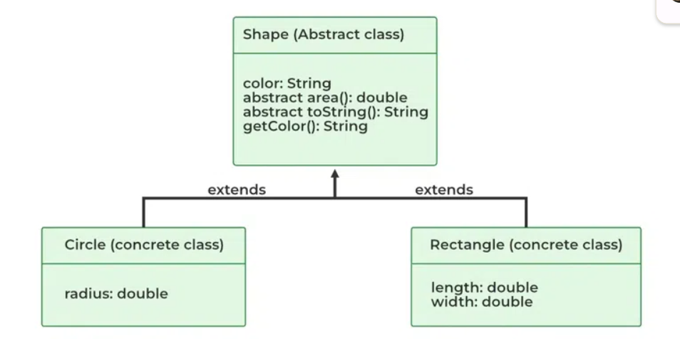
When to Use Abstract Classes and Abstract Methods?
There are situations in which we will want to define a superclass that declares the structure of a given abstraction without providing a complete implementation of every method. Sometimes we will want to create a superclass that only defines a generalization form that will be shared by all of its subclasses, leaving it to each subclass to fill in the details.
Consider a classic “shape” example, perhaps used in a computer-aided design system or game simulation. The base type is “shape” and each shape has a color, size, and so on. From this, specific types of shapes are derived(inherited)-circle, square, triangle, and so on — each of which may have additional characteristics and behaviors. For example, certain shapes can be flipped. Some behaviors may be different, such as when you want to calculate the area of a shape. The type hierarchy embodies both the similarities and differences between the shapes.

Slide 25
Interface
Interfaces are another method of implementing abstraction in Java. The key difference is that, by using interfaces, we can achieve 100% abstraction in Java classes. In Java or any other language, interfaces include both methods and variables but lack a method body. Apart from abstraction, interfaces can also be used to implement inheritance in Java.
Implementation: To implement an interface we use the keyword “implements” with class.
Advantages of Abstraction
Simplifies complex systems by hiding implementation details.
Increases code reusability and maintainability.
Enhances security by exposing only essential features.
Improves modularity and separation of concerns.
Provides a clear and user-friendly interface.
Disadvantages of Abstraction
It can add unnecessary complexity if overused.
May reduce flexibility in implementation.
Makes debugging and understanding the system harder for unfamiliar users.
Overhead from abstraction layers can affect performance.

Slide 26

Encapsulation
Encapsulation in Java is a fundamental OOP (object-oriented programming) principle that combines data and methods in a class. It allows implementation details to be hidden while exposing a public interface for interaction.
// Java program demonstrating Encapsulation
class Programmer {
private String name;
public String getName() { return name; } // Getter and Setter for name
public void setName(String name) { this.name = name; }
}
public class Test {
public static void main(String[] args) {
Programmer p = new Programmer();
p.setName(“Test");
System.out.println("Name=> " + p.getName());
}
}

Slide 27
Explanation: In this example, the class restricts direct access to it from outside. The getName() and setName() methods, known as getters and setters, provide controlled access to the name attribute. This encapsulation mechanism protects the internal state of the Programmer object and allows for better control and flexibility in how the name attribute is accessed and modified.
Implementation of Java Encapsulation
In Java, encapsulation is implemented by declaring instance variables as private, restricting direct access. Public getter methods retrieve variable values, while setter methods modify them, enabling controlled access. This approach allows the class to enforce data validation and maintain a consistent internal state, enhancing security and flexibility.
Encapsulation is defined as the wrapping up of data under a single unit. It is the mechanism that binds together code and the data it manipulates. Another way to think about encapsulation is, that it is a protective shield that prevents the data from being accessed by the code outside this shield.
In encapsulation, the variables or data of a class are hidden from any other class and can be accessed only through any member function of its own class.
A private class can hide its members or methods from the end user, using abstraction to hide implementation details, by combining data hiding and abstraction.
Encapsulation can be achieved by Declaring all the variables in the class as private and writing public methods in the class to set and get the values of variables.
It is more defined with the setter and getter method.

Slide 28
Advantages of Encapsulation
Data Hiding: Encapsulation provides data hiding. Users don’t see the implementation of the class. The user only knows that we are passing the values to a setter method and variables are getting initialized with that value.
Data Integrity: By using getter and setter methods, we can ensure that only valid data is assigned to variables. If we omit the setter methods, we make the variables read-only, and if we omit the getter methods, we make them write-only. This ensures the internal state of the object is protected and maintains data integrity.
Reusability: Encapsulation also improves the re-usability and is easy to change with new requirements.
Testing code is easy: Encapsulated code is easy to test for unit testing.
Freedom of advantages the details: one of the major advantages of encapsulation is that it gives the programmer freedom to implement the details of a system. The only constraint on the programmer is to maintain the abstract interface that outsiders see.
Disadvantages of Encapsulation in Java
It can lead to increased complexity, especially if not used properly.
It can make it more difficult to understand how the system works.
This may limit the flexibility of the implementation.

Slide 29
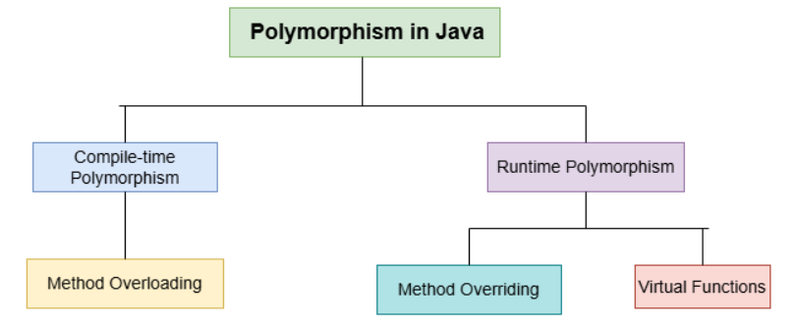
Polymorphism
The word ‘polymorphism’ means ‘having many forms’. In Java, polymorphism refers to the ability of a message to be displayed in more than one form. This concept is a key feature of Object-Oriented Programming and it allows objects to behave differently based on their specific class type.
Real-life Illustration of Polymorphism in Java: A person can have different characteristics at the same time. Like a man at the same time is a father, a husband, and an employee. So the same person possesses different behaviors in different situations. This is called polymorphism.
Types of Java Polymorphism
In Java Polymorphism is mainly divided into two types:
Compile-Time Polymorphism
Runtime Polymorphism

Slide 30
// Base class Person
class Person {
// Method that displays the role of a person
void role() {
System.out.println("I am a person.");
} }
// Derived class Father that overrides the role method
class Father extends Person {
@Override // Overridden method to show the role of a father
void role() {
System.out.println("I am a father.");
} }
public class Main {
public static void main(String[] args) {
// Creating a reference of type Person but initializing it with Father class object
Person p = new Father();
// Calling the role method. It calls the overridden version in Father class
p.role();
} }
Explanation: In the above example, the Person class has a method role() that prints a general message. The Father class overrides role() to print a specific message. The reference of type Person is used to point to an object of type Father, demonstrating
polymorphism at runtime. The overridden
method in Father is invoked when role() is called.

Slide 31
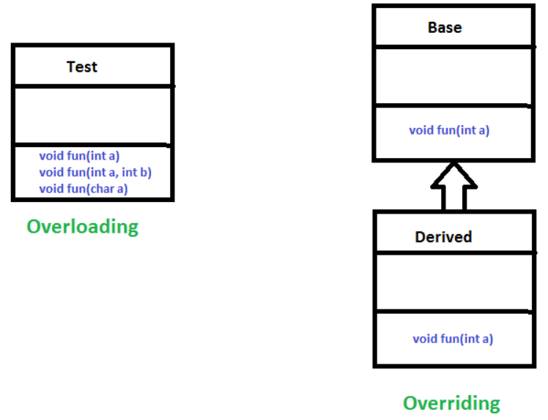
Compile-Time Polymorphism: Compile-Time Polymorphism in Java is also known as static polymorphism. This type of polymorphism is achieved by function overloading or operator overloading.
Method Overloading
Method overloading in Java means when there are multiple functions with the same name but different parameters then these functions are said to be overloaded. Functions can be overloaded by changes in the number of arguments or/and a change in the type of arguments.

Slide 32
// Method overloading By using Different Types of Arguments
// Class 1 Helper class
class Helper {
// Method with 2 integer parameters
static int Multiply(int a, int b)
{
return a * b; // Returns product of integer numbers
}
// Method 2 With same name but with 2 double parameters
static double Multiply(double a, double b)
{
// Returns product of double numbers
return a * b;
} }
// Class 2 Main class
class Test
{
public static void main(String[] args) { // Main driver method
System.out.println(Helper.Multiply(2, 4)); // Calling method by passing input as in arguments
System.out.println(Helper.Multiply(5.5, 6.3));
} }

Slide 33
Subtypes of Compile-time Polymorphism:
Function Overloading: It is a feature in C++/Java where multiple functions can have the same name but with different parameter lists. The compiler will decide which function to call based on the number and types of arguments passed to the function.
Operator Overloading: It is a feature in C++ where the operators such as +, -, *, etc. can be given additional meanings when applied to user-defined data types.
Template: It is a powerful feature in C++ that allows us to write generic functions and classes. A template is a blueprint for creating a family of functions or classes.
2. Runtime Polymorphism
Runtime Polymorphism in Java known as Dynamic Method Dispatch. It is a process in which a function call to the overridden method is resolved at Runtime. This type of polymorphism is achieved by Method Overriding. Method overriding, on the other hand, occurs when a derived class has a definition for one of the member functions of the base class. That base function is said to be overridden.
Subtype of Run-Time Polymorphism
Virtual Functions: It allows an object of a derived class to behave as if it were an object of the base class. The derived class can override the virtual function of the base class to provide its own implementation. The function call is resolved at runtime, depending on the actual type of the object.

Slide 34
Advantages of Polymorphism
Increases code reusability by allowing objects of different classes to be treated as objects of a common class.
Improves readability and maintainability of code by reducing the amount of code that needs to be written and maintained.
Supports dynamic binding, enabling the correct method to be called at runtime, based on the actual class of the object.
Enables objects to be treated as a single type, making it easier to write generic code that can handle objects of different types.
Disadvantages of Polymorphism
Can make it more difficult to understand the behavior of an object, especially if the code is complex.
This may lead to performance issues, as polymorphic behavior may require additional computations at runtime.

